Slide 1
Operators in Python
Simple Explanation with Examples

Slide 2
1. Arithmetic Operators
+ : Addition → 5 + 3 = 8
- : Subtraction → 10 - 4 = 6
* : Multiplication → 6 * 2 = 12
/ : Division → 7 / 2 = 3.5
// : Floor Division → 7 // 2 = 3
% : Modulus → 7 % 2 = 1
** : Exponent → 2 ** 3 = 8

Slide 3
2. Comparison Operators
== : Equal → 5 == 5 → True
!= : Not equal → 5 != 3 → True
> : Greater than → 7 > 2 → True
< : Less than → 4 < 9 → True
>= : Greater or equal → 5 >= 5 → True
<= : Less or equal → 3 <= 5 → True

Slide 4
3. Assignment Operators
= : Assign → x = 10
+= : Add and assign → x += 5
-= : Subtract and assign → x -= 3
*= : Multiply and assign → x *= 2
/= : Divide and assign → x /= 2
//= : Floor divide and assign
%= : Modulus and assign
**= : Exponent and assign

Slide 5
4. Logical Operators
and : True if both are True → (5 > 2 and 3 < 4) → True
or : True if at least one is True → (5 > 10 or 3 < 4) → True
not : Reverses result → not(5 > 2) → False

Slide 6
5. Bitwise Operators
& : AND → 5 & 3 = 1
| : OR → 5 | 3 = 7
^ : XOR → 5 ^ 3 = 6
~ : NOT → ~5 = -6
<< : Left shift → 5 << 1 = 10
>> : Right shift → 5 >> 1 = 2

Slide 7
6. Membership Operators
in : Checks if value is inside → 'a' in 'apple' → True
not in : Checks if value is not inside → 'x' not in 'apple' → True

Slide 8
7. Identity Operators
is : True if two variables point to same object
is not : Opposite of is
Example: x = [1,2,3]; y = x; z = [1,2,3]
x is y → True, x is z → False

Slide 9
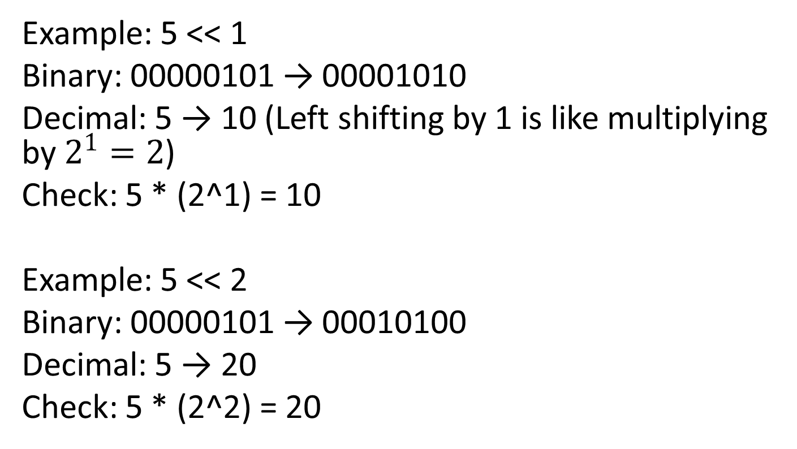
Left Shift (<<) Step by Step
Example: 5 << 1
Binary: 00000101 → 00001010
Decimal: 5 → 10 (Left shifting by 1 is like multiplying by $2^{1}=2$)
Check: 5 * (2^1) = 10
Example: 5 << 2
Binary: 00000101 → 00010100
Decimal: 5 → 20
Check: 5 * (2^2) = 20

Slide 10
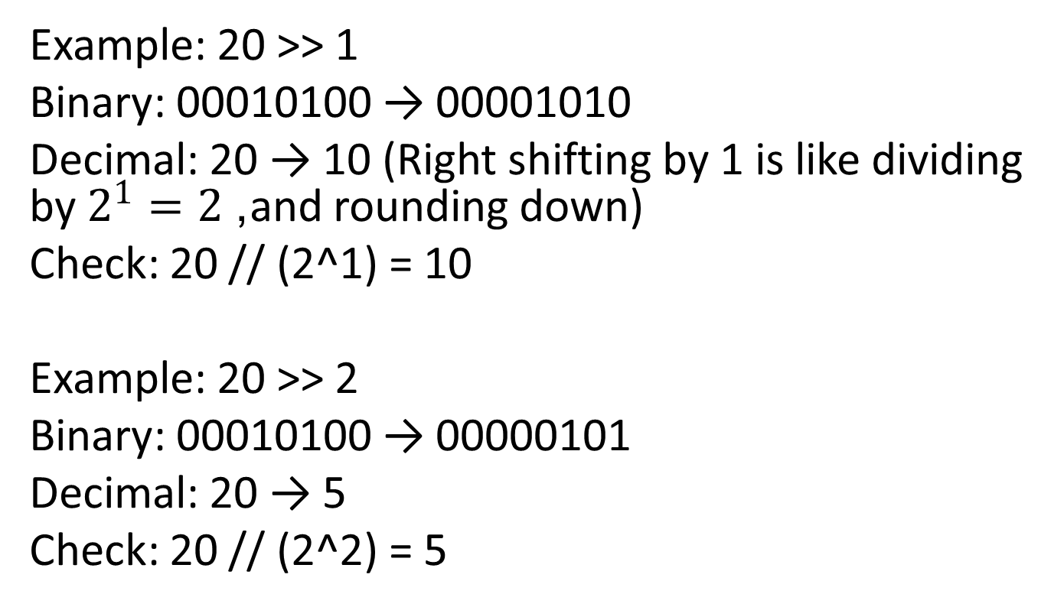
Right Shift (>>) Step by Step
Example: 20 >> 1
Binary: 00010100 → 00001010
Decimal: 20 → 10 (Right shifting by 1 is like dividing by $2^{1}=2$, and rounding down)
Check: 20 // (2^1) = 10
Example: 20 >> 2
Binary: 00010100 → 00000101
Decimal: 20 → 5
Check: 20 // (2^2) = 5

